Slide 1
A Primer on PowerShell
Steven Howe Feb. 2022

Slide 2
Outline
What is this you speak of?
What is PowerShell?
History
Versions
Download
Help me!
Using help documentation
Finding commands
Properties and methods of commands
Finding modules
Where am I?
Location and listing commands

Slide 3
Outline (cont’d)
Getting creative!
Creating files and folders
Let’s move it!
Moving items
Copycat!
Copying items
Being picky!
Filtering output
Looks Good!
Formatting commands

Slide 4
Outline (cont’d)
Being mischievous!
Exploring useful PS for pentesting
List of PS exploitation frameworks
That’s all folks!

Slide 5

What is it?
“PowerShell is a cross-platform task automation solution made up of a command-line shell, a scripting language, and a configuration management framework.”
Built on the .NET framework
Input and output are .NET objects
“.NET is a free, cross-platform, open-source developer platform for building many different types of applications. With .NET, you can use multiple languages, editors, and libraries to build for web, mobile, desktop, games, and IoT…You can write .NET apps in C#, F#, or Visual Basic.”
Newer versions are generally compatible with previously released versions
Notes:
Test test test

Slide 6
History
(Late 1990’s)
Intel came to Microsoft to get help in creating a better platform for development of their CPUs. They had automation scripts called KornShell. Microsoft started to port these scripts over to Windows from the Unix variants they were originally created for.
(2002)
Microsoft created a new CLI called Monad with help from the chief architect, Jeffrey Snover. Goal was to make Unix tools available on Windows. However, Linux cmd is text file based and Windows is API based.
(2006)
Monad is renamed to Windows PowerShell and released with Windows as a component instead of just an add-on.

Slide 7
Versions
Windows PowerShell 1.0
Released in 2006 for Windows XP, Sever 2003, and Vista.
Windows PowerShell 2.0
Released in 2009 for Windows XP, Sever 2003, Vista, Sever 2008, and Windows 7.
Some new features: PS remoting, background jobs, modules, script debugging, PS Integrated Scripting Environment (ISE), network file transfers using BITS, etc.
Windows PowerShell 3.0
Released in 2012 for Windows 8, Server 2012, Windows 7, and Server 2008.
Some new features: scheduled jobs, session connectivity, code completion, automatic module detection, many new commands including Update-Help command, etc.

Slide 8
Versions
Windows PowerShell 4.0
Released in 2013 for Windows 8.1, Server 2012, Server 2008, and Windows 7.
Some new features: Enhanced debugging, network diagnostics, Where and ForEach methods, PipelineVariable switch, etc.
Windows PowerShell 5.0 & 5.1
Released in 2016 for Windows 10 for Windows 10, Server 2016, Server 2012, and Windows 8.1.
Some new features: Creation of classes, debugging for background jobs, desired state configuration (DSC), multiple new cmdlets, etc.
Version 5.1 was first to come in Desktop and Core editions. Core runs on .NET core, had smaller footprint and lacked some features of Desktop edition.
PowerShell Core 6
Released in 2018, Microsoft decided to make it cross-platform, free, and open source.
No other new major features were implemented.
PowerShell 7
Released in 2020.
Some new features: Parallel switch for parallel processing, new error view, pipeline chaining operators, etc.

Slide 9
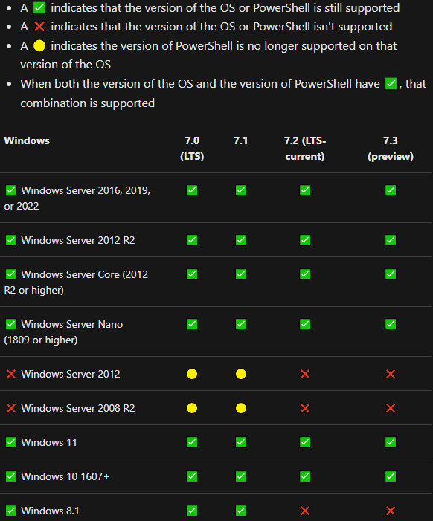
PS Versions and Platforms Supported

Slide 10
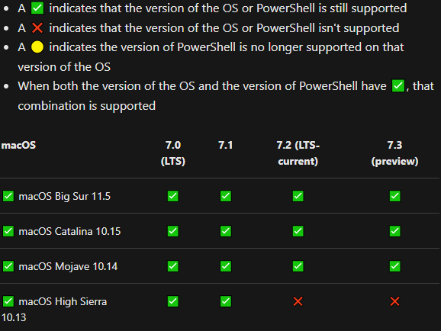
PS Versions and Platforms Supported

Slide 11
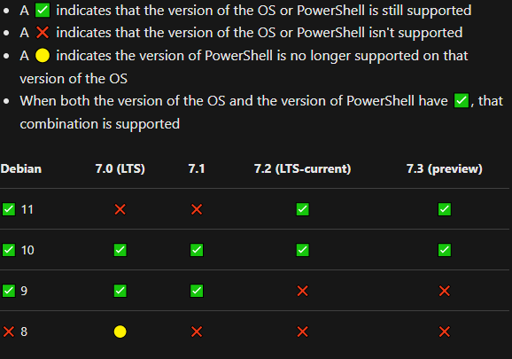
PS Versions and Platforms Supported

Slide 12
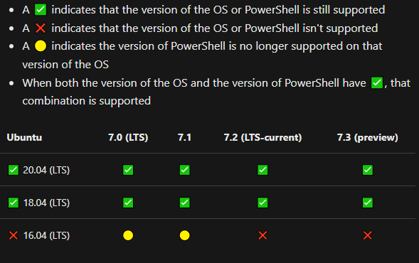
PS Versions and Platforms Supported

Slide 13
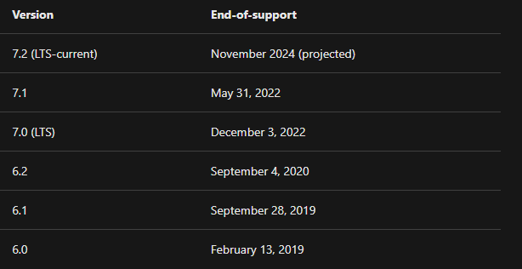
PS End of Support Dates

Slide 14
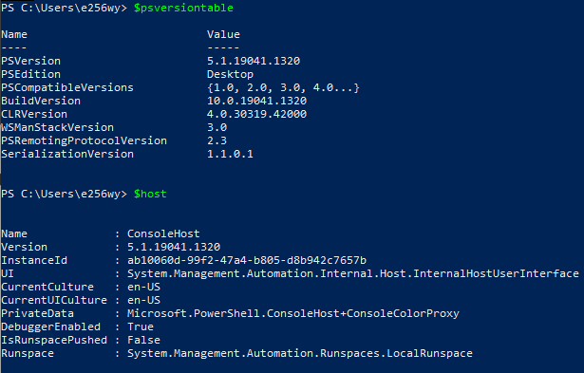
Determining Your Version of PS

Slide 15
Installation (Windows)
There are multiple ways to install PowerShell on Windows:
MSI package:
https://docs.microsoft.com/en-us/powershell/scripting/install/installing-powershell-on-windows?view=powershell-7.2#msi
ZIP package:
https://docs.microsoft.com/en-us/powershell/scripting/install/installing-powershell-on-windows?view=powershell-7.2#zip
.NET global tool:
https://docs.microsoft.com/en-us/powershell/scripting/install/installing-powershell-on-windows?view=powershell-7.2#dotnet
Winget:
https://docs.microsoft.com/en-us/powershell/scripting/install/installing-powershell-on-windows?view=powershell-7.2#winget
Microsoft store package:
https://docs.microsoft.com/en-us/powershell/scripting/install/installing-powershell-on-windows?view=powershell-7.2#msstore

Slide 16
Installation (Debian Linux)
Can be installed on Debian Linux via direct download or package repository
Direct download:
(PowerShell 7.2.1) https://github.com/PowerShell/PowerShell/releases/download/v7.2.1/powershell-lts_7.2.1-1.deb_amd64.deb
Package repository:
(Debian 10)
# Download the Microsoft repository GPG keys
wget https://packages.microsoft.com/config/debian/10/packages-microsoft-prod.deb
# Register the Microsoft repository GPG keys
sudo dpkg -i packages-microsoft-prod.deb
# Update the list of products
sudo apt-get update
# Install PowerShell
sudo apt-get install -y powershell
# Start PowerShell
pwsh

Slide 17
Help me! (Get-Help)
Cmdlets are compiled commands in PS and follow the <Verb>-<Noun> syntax. They are case insensitive.
Update-Help : Downloads the most current help files
Get-Help : Used to learn about a cmdlet or to help locate a cmdlet
To see what you can do with this just enter Get-Help
Parameters can be given to limit the scope of what is returned e.x. Full, Detailed, Examples, Online, Parameter, ShowWindow
Use only ‘Help’ to have results returned one page at a time
Help Get-Help –Parameter Name : Displays help information on the Get-Help parameter called “Name”

Slide 18
Help me! (Get-Help)
Help *table*: Used to locate any cmdlet that contains the word table in it
Help *com*ter* : Used to locate any cmdlet that has the letters “com” preceding the letters “ter” somewhere in its name
When no matches are found for cmdlet names, it will automatically search every help topic on the system to return any matches

Slide 19
Help me! (Get-Command)
Get-Command : Used to help locate commands
Running just “Get-Command” lists all commands on the system
Help get-command –Parameter * : Shows all the possible parameters that can be used with Get-Command
Get-Command -Verb <term>: Used to search commands that contain the given term in the verb portion of the <Noun>-<Verb> syntax
Parameters
“-Noun <term>” : Used to search the noun portion
“-Name <term>” : Used to search anywhere in the name

Slide 20
Help me! (Get-Command)
Get-Command –Module Microsoft.PowerShell.Security : Used to display all the commands contained within this specific module
(Get-Command Get-Date).ModuleName : Gets the module name that contains this specific cmdlet
Get-Command Start-PowerShell : Gets information about a specific cmdlet
Get-Command –ParameterName *Auth* : Used to get all cmdlets with a parameter name that includes “auth”
Get-Command get-commnd –UseFuzzyMatching : If you’re not sure on spelling, use this parameter to find the best match

Slide 21
Help me! (Get-Member)
<cmdlet> | Get-Member: This is used to show what objects, properties, and methods are available for a given command
Property: A characteristic of something
Method: An action that can be taken
<cmdlet> | Get-Member –MemberType Properties : Used to show only the properties of a cmdlet
<cmdlet> | Get-Member –MemberType Method: Used to show only the methods of a cmdlet

Slide 22
Help me! (Get-Module, Import-Module, Install-Module)
“A module is a package that contains members that can be used in PowerShell. Members include cmdlets, providers, scripts, functions, variables, and other tools and files.”
Get-Module: Used to list the modules that have already been imported to the current session
“–ListAvailable” : Parameter used to list all the modules that are available to be imported
Import-Module: Used to add one or more modules to the current session, provides more flexibility
Modules are automatically imported when using any of the commands that are provided in the module since PS 3.0
Install-Module: Used to download modules from a repository
PowerShell Gallery | Home

Slide 23
Where am I? (Get-Location, Set-Location, Push-Location, Pop-Location)
Get-Location : Cmdlet used to represent the current working directory
Can use the familiar ‘pwd’ alias to produce same output
Set-Location: Cmdlet used to set the working location to a specified path
Aliases: cd, chdir, and sl
Get-Location –PSDrive D : Will display the current location in D drive even if your current directory is in a separate drive
Push-Location : Will push the current location onto a location stack
Pop-Location : Changes the current location to the most recently pushed location on the stack

Slide 24
Where am I? (Get-ChildItem)
Get-ChildItem : Used to display items in a given location
By default, it doesn’t display empty directories
Alias: ls, dir, or gci
Get-ChildItem -Path C:\Windows : Will display mode, last write time, length, and name of items of remote location
Get-ChildItem -Path C:\Windows –Name : Will only display the names of files and directories
Get-ChildItem -Path C:\Windows –Recurse : Will recursively display all directories and files
Get-ChildItem -Path C:\Windows –Depth 3 : Will recursively display all directories and files 3 levels down

Slide 25
Where am I? (Get-ChildItem)
Get-ChildItem –Path C:\Windows\* –Include *.txt : This will limit list results to only files that have “.txt” extension
Get-ChildItem –Path C:\Windows\* –Exclude W*: This will exclude any list results whose name begin with “W”
Get-ChildItem –Hidden : Displays hidden files and folders
Get-ChildItem –Directory : Displays only directories in results

Slide 26
Getting creative (New-Item)
New-Item : Command used to create new items and set their initial values
Type of item created depends on its location
Alias: ni
New-Item -Path . -Name "test.txt" -ItemType "file" -Value “This is my new file!“ : Used to create a file called “test.txt” in the current directory with the contents of “This is my new file!“
Can use the –Force parameter to overwrite the contents of a file
New-Item -ItemType "file" -Path "c:\test.txt", "c:\test.log“ : Used to create multiple files at one time
New-Item -ItemType SymbolicLink -Path .\link -Target .\MyFolder : Creates a link to a created folder

Slide 27
Let’s move it! (Move-Item)
Move-Item : Command to move an item from one location to another including its properties, contents, and child items
Move-Item -Path C:\test.txt -Destination E:\Temp\renamed.txt : Moves a file to another directory and renames the file
Move-Item -Path .\*.txt -Destination C:\Logs : Moves all “.txt” files in the current directory to Logs
Move-Item -Path C:\Temp -Destination C:\Documents : Moves the folder and its contents to the Documents folder
The “-Include” and “-Exclude” parameters can be used with wildcards to move many items at once

Slide 28
Copycat! (Copy-Item)
Copy-Item : Used to copy an item from one location to another and can also be used to rename items
Copy-Item “C:\Temp\temp.txt” –Destination “D:\Documents” : Used to copy the file to the Documents folder
Copy-Item -Path "C:\Logfiles\*" -Destination "C:\Docs" –Recurse : Recursively copies all folder contents, preserving folder structure, into the Docs folder
Copy-Item “C:\Logs\logs.log” –Destination “D:\Documents\test.txt” : Used to copy the file to the Documents folder and renames the file
The “-Include” and “-Exclude” parameters can be used with wildcards to copy many items at once

Slide 29
Being picky! (Select-Object)
Select-Object : Used to select specific properties of objects, select unique objects, a specified number of objects, or objects in a specified position in an array
Get-Process | Select-Object -Property ProcessName, Id, WS : Used to only display specific properties from the object
"a","b","c","a","a","a" | Select-Object –Unique : Displays only unique characters from the array
<command> | Select-Object –Skip 3 : Selects all but the first 3 object items
Parameters
“-First <num>” : Selects the nth number of objects from the beginning of an array
“-Last <num>”: Selects objects from the end of an array
“-Index <num>”: Selects objects based on index values in array

Slide 30
Being picky! (Where-Object)
Where-Object : Used to select objects based on their property values, comparison operators can be used to fine-tune results
Can use script block format or comparison statement format
Get-Service | Where-Object {$_.Status -eq "Stopped"} : Used to retrieve service objects whose status is “Stopped”
Get-Process | Where-Object ProcessName -Match "^p.*“ : Used to get processes that start with “p” by using regex
Get-Module -ListAvailable | where {($_.Name -notlike "Microsoft*" -and $_.Name -notlike "PS*") : Used to retrieve non-core modules

Slide 31
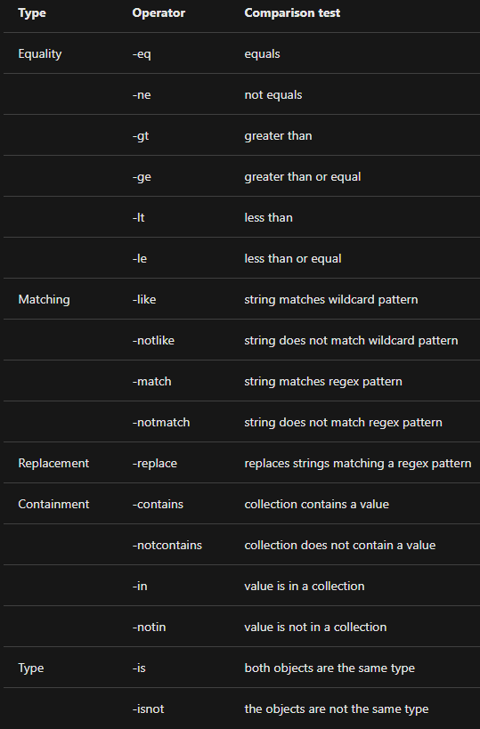
Comparison Operators

Slide 32
Looks good! (Format-List)
Format-List : Used to format the output of a command where each property is displayed on a separate line. Since there’s more space, PS will display more properties of the object
Get-Service | Format-List : Displays the Get-Service properties in list format
Get-Process | Format-List -Property name, basepriority, priorityclass : Displays only the selected properties in list format

Slide 33
Looks good! (Format-Table)
Format-Table : Used to display the properties of an object in a column. The object type determines the default layout and which properties are displayed. Custom views for tables can be created and indicated using the “-View” parameter
Get-Host | Format-Table –AutoSize : Displays the default table layout of the Get-Host command and adjusts the column widths to minimize truncation
Get-Service | Format-Table -Property Name, DependentServices : Displays a two-column table using the two specified properties
Parameters
“-HideTableHeaders” : Gets rid of the table headings
“-RepeatHeader” : Redisplays the header, useful when paging
“-Wrap” : Displays text that exceeds the column width on the next line

Slide 34
Being mischievous! (PS for pentesters)
gci c:\ -Include *pass*.txt,*pass*.xml,*pass*.ini,*pass*.xlsx,*cred*,*vnc*,*.config*,*accounts* -File -Recurse -EA SilentlyContinue : Used to identify files that may contain sensitive data
gci c:\ -Include *.txt,*.xml,*.config,*.conf,*.cfg,*.ini -File -Recurse -EA SilentlyContinue | Select-String -Pattern "password“ : Used to find config files that contain the text “password”
[Windows.Security.Credentials.PasswordVault,Windows.Security.Credentials,ContentType=WindowsRuntime];(New-Object Windows.Security.Credentials.PasswordVault).RetrieveAll() | % { $_.RetrievePassword();$_ } : Retrieve stored passwords from Windows PasswordVault

Slide 35
Being mischievous! (PS for pentesters)
Get-StoredCredential | % { write-host -NoNewLine $_.username; write-host -NoNewLine ":" ; $p = [System.Runtime.InteropServices.Marshal]::SecureStringToBSTR($_.password) ; [System.Runtime.InteropServices.Marshal]::PtrToStringAuto($p); } : Used to get stored passwords from Windows Credential Manager
[System.Text.Encoding]::UTF8.GetString([System.Security.Cryptography.ProtectedData]::Unprotect($datarow.password_value,$null,[System.Security.Cryptography.DataProtectionScope]::CurrentUser)) : Used to get stored passwords from Chrome browser
gci HKLM:\SYSTEM\CurrentControlSet\Services\SNMP -Recurse -EA SilentlyContinue : Used to search for SNMP community strings in the registry

Slide 36
Being mischievous! (PS for pentesters)
gp 'HKCU:\Software\Policies\Microsoft\Windows\Installer' -Name AlwaysInstallElevated gp 'HKLM:\Software\Policies\Microsoft\Windows\Installer' -Name AlwaysInstallElevated : Used to check if AlwaysInstallElevated is enabled
gwmi -class Win32_Service -Property Name, DisplayName, PathName, StartMode | Where {$_.StartMode -eq "Auto" -and $_.PathName -notlike "C:\Windows*" -and $_.PathName -notlike '"*'} | select PathName,DisplayName,Name : Used to find unquoted service paths
$net = "10.10.1." 0..255 | foreach {$r=(Resolve-DNSname -ErrorAction SilentlyContinue $net$_ | ft NameHost -HideTableHeaders | Out-String).trim().replace("\s+","").replace("`r","").replace("`n"," "); Write-Output "$net$_ $r"} | tee ip_hostname.txt : Used to conduct host discovery of the 10.10.1.0/24 network using reverse DNS

Slide 37
Being mischievous! (PS for pentesters)
$ports = "21 22 23 25 53 80 88 111 139 389 443 445 873 1099 1433 1521 1723 2049 2100 2121 3299 3306 3389 3632 4369 5038 5060 5432 5555 5900 5985 6000 6379 6667 8000 8080 8443 9200 27017" $ip = "10.10.15.232" $ports.split(" ") | % {echo ((new-object Net.Sockets.TcpClient).Connect($ip,$_)) "Port $_ is open on $ip"} 2>$null : Used to display if specific ports are open on 10.10.15.232
new-item "c:\users\public\share" -itemtype directory New-SmbShare -Name "sharedir" -Path "C:\users\public\share" -FullAccess "Everyone","Guests","Anonymous Logon“ : Used to create a SMB shared drive accessible by anyone for transferring files or exfiltration
New-NetFirewallRule -Action Allow -DisplayName "pentest" -RemoteAddress 10.10.15.123 : Used to whitelist the specific IP address from Windows firewall

Slide 38
PowerShell Exploitation Frameworks
Only some of the available frameworks which are written completely in PowerShell or that use PowerShell agents.
PoshSec
PowerSploit
PowerUp
Empire
Veil-PowerView
FudgeC2
iBombShell
Octopus C2
PoshC2
SQLc2

Slide 39
That’s all folks!

